Slide 1
Inference in FOL
Dave Touretzky
Read R&N Ch. 9.1-9.4

Slide 2
Review: How to do automated inference in FOL
Reduction to propositional inference — previous lecture
Models are potentially infinite
But any true sentence can be proved in a finite model
Horn theories:
  Forward chaining
  Backward chaining
Resolution theorem proving — next lecture
This lecture

Slide 3
Review: propositional Modus Ponens
α ⇒ β , α
-----------------
β
Here, α and β can be any propositional formula.
What happens when we add variables?

Slide 4
Variable substitution drives inference in FOL
Given a sentence
Man(x) ⇒ Mortal(x)
and another sentence
Man(socrates)
Apply the substitution θ = { x / socrates } to derive
Man(socrates) ⇒ Mortal(socrates)
Then we can apply Modus Ponens to conclude
Mortal(socrates)

Slide 5
Generalized Modus Ponens
Let p_{i}, p_{i}’, be atomic sentences where there is a substitution θ such that SUBST(θ,p_{i}’) = SUBST(θ,p_{i}) for 1 ≤ i ≤ n. Let q also be an atomic sentence. Then the Generalized Modus Ponens inference rule is:
p₁’, p₂’, …, p_{n}’ , p₁ ∧ p₂ ∧ … ∧ p_{n} ⇒ q
---------------------------------------------------------
SUBST(θ,q)
This is a lifted (more abstract) version of Modus Ponens, allowing us to move beyond ground (variable-free) statements.
Why the restriction to atomic sentences?

Slide 6
Lifted inference algorithms
We can develop lifted versions of:
Forward chaining
Backward chaining
Resolution theorem proving
More efficient than universal instantiation: can focus on just the sentences relevant to our inference rules.
But where does the substitution θ come from?

Slide 7
Unification
Given two sentences p and q, a unifier θ of p and q is a substitution such that
SUBST(θ,p) = SUBST(θ,q)
Knows(john, x) Knows(john, jane) θ = { x / jane }
Knows(john, x) Knows(y, bill) θ = { x / bill, y / john }
Knows(john, x) Knows(y, mother(y)) θ = { y / john, x / mother(john) }
Knows(john, x) Knows(x, elizabeth) fail even though everyone knows Liz
Standardizing apart:
Knows(john, x₁) Knows(x₂, elizabeth) θ = { x₁ / elizabeth, x₂ / john }

Slide 8
Most general unifier
What are the legal unifiers of
Knows(john, x) Knows(y, z)
θ = { x / john, y / john, z / john } gives Knows(john, john)
θ = { y / john, x / z} ⇠ MGU gives Knows(john, z)
Every pair of sentences has a MGU that is unique up to variable renaming.
The MGU is what we want to use for inference.

Slide 9

Occurs check
A variable cannot unify with a formula that contains that variable.
For example:
f(x) cannot unify with f(f(x)) θ = { x / f(x) }
Occurs checks make unification quadratic in the length of the expression.
Some inference systems skip them, for efficiency’s sake.

Slide 10
Unifying a variable with something
function UNIFY-VAR(var, x, θ) returns a substitution
if { var / val } ∊ θ then return UNIFY(val, x, θ)
else if { x / val } ∊ θ then return UNIFY(var, val, θ)
else if OCCUR-CHECK?(var, x) then return failure
else return θ + { var / x }

Slide 11
function UNIFY(x, y, θ={ }) returns a most general unifier
inputs: x, y: variables, constants, lists, or compound expressions
θ: a substitution
if θ = failure then return failure
else if x = y then return θ
else if VARIABLE?(x) then return UNIFY-VAR(x, y, θ)
else if VARIABLE?(y) then return UNIFY-VAR(y, x, θ)
else if COMPOUND?(x) and COMPOUND(y) then
return UNIFY(x.args, y.args, UNIFY(x.op, y.op, θ))
else if LIST?(x) and LIST?(y) then
return UNIFY(x.rest, y.rest, UNIFY(x.first, y.first, θ))
else return failure

Slide 12
Try out the unification code in logic2.py
>> unify(expr(‘Knows(John,x)’), expr(‘Knows(y,z)’), { })
{ x: z, y: John }
>> unify(expr(‘f(x)’), expr(‘f(f(A))’), { })
{ x: f(A) }
>> unify(expr(‘f(x)’), expr(‘f(f(x))’), { })
None

Slide 13
Database fetch
Find all the facts in a database that unify with a query.
Employs(IBM, Richard) Does IBM employ Richard?
Employs(x, Richard) Who employs Richard?
Employs(IBM, y) Who does IBM employ?
Employs(x,y) Who employs whom?
If the database contains many different kinds of facts, indexing can make retrieval more efficient.
Can index on the predicate, or on predicate/argument combinations.

Slide 14
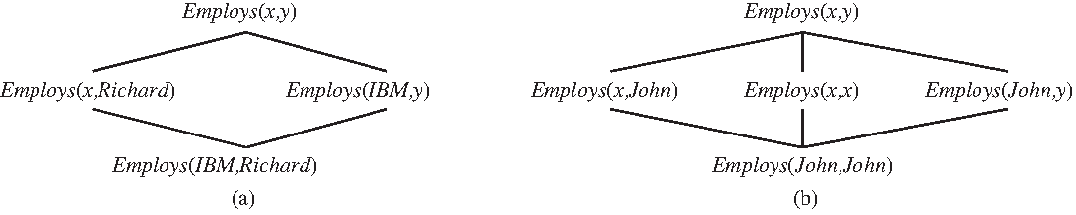
Subsumption relations among queries
Every ground term is the base of a lattice of increasingly abstract queries.
Could index on some of these combinations, depending on utility.

Slide 15
Forward Chaining

Slide 16
Forward chaining algorithm
Start with a set of atomic sentences and definite clauses
Repeatedly apply Modus Ponens until either:
the desired answer is reached, or
no further inferences can be made

Slide 17
First order definite clauses
All terms are positive literals.
Facts: P(a), R(b,c), S(x,d)
Implications: p₁ ∧ p₂ ∧ … ∧ p_{n}⇒ q
Example:
King(x) ∧ Greedy(x) ⇒ Evil(x)
King(John)
Greedy(y)
MGU: { x / John, y / x }

Slide 18
Forward chaining example
American(x) ∧ Weapon(y) ∧ Sells(x,y,z) ∧ Hostile(z) ⇒ Criminal(x)
Missile(x) ⇒ Weapon(x)
Missile(m₁)
Owns(nono, m₁)
Missile(x) ∧ Owns(nono, x) ⇒ Sells(west, x, nono)
Enemy(x, america) ⇒ Hostile(x)
American(west)
Enemy(nono, america)

Slide 19
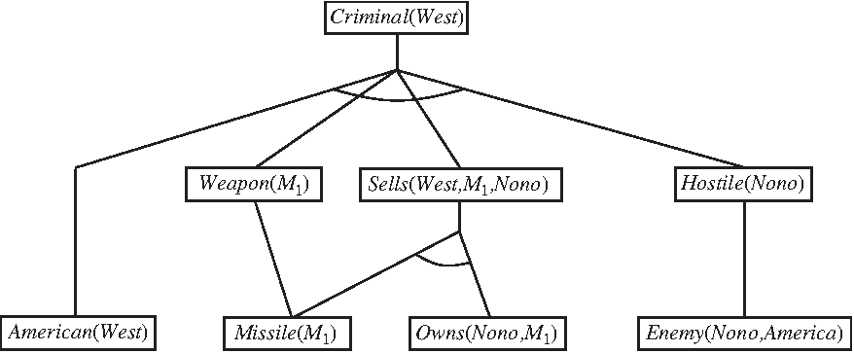
Forward chaining derivation of Criminal(west)
1
2
5
6

Slide 20
Datalog knowledge bases
Datalog: language with first order definite clauses and no function symbols.
Represents the kind of information found in relational databases.
For a Datalog knowledge base, forward chaining is:
Sound: all inferences are valid
Complete: all valid inferences are derivable
Limited to p×n^{k} ground instances (p = # predicates, k = max arity, n = # const)
On the other hand, if we allow function symbols, then forward chaining may never terminate. Entailment is only semi-decidable, even when our language is restricted to definite clauses.

Slide 21
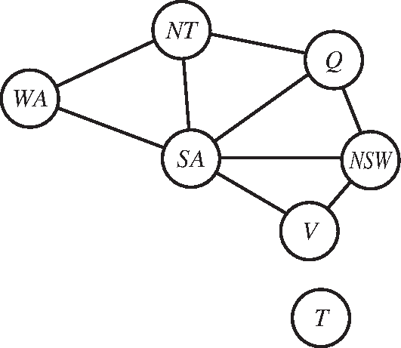
Inference as constraint satisfaction (NP hard)
Diff(wa,nt) ∧ Diff(wa,sa) ∧ Diff(nt,q) ∧
Diff(nt,sa) ∧ Diff(q,nsw) ∧ Diff(q,sa) ∧
Diff(nsw,v)∧ Diff(nsw,sa) ∧ Diff(v,sa)
⇒ Colorable()
Diff(red,blue) Diff(blue,red)
Diff(red,green) Diff(green,red)
Diff(blue,green) Diff(green,blue)
Since CSPs include 3-SAT as a special case, we see that matching a definite clause against a set of facts is NP-hard.

Slide 22
Making forward chaining more efficient (1)
On each iteration i of the forward chaining algorithm, every new fact must be derived from at least one new fact that was derived on iteration i-1.
(Why?)
Therefore, we need only consider rules that mention at least one fact derived at step i-1.
If there are many rules, we can use indexing to efficiently locate the relevant ones.

Slide 23
Making forward chaining more efficient (2)
Rules with many antecedents may not fully match on iteration i, but after more inference is done, they could fully match later.
Instead of recomputing matches from scratch on each iteration, cache the results of partial matches and incrementally update them on each iteration.
The rete algorithm used in the OPS-5 production system language works this way.
Cognitive architectures such as ACT and SOAR tend to have many rules and only small numbers of facts.
Some production systems have tens of millions of rules but can run in real time thanks to efficient matching.

Slide 24
Making forward chaining efficient (3)
Use tricks to ensure that only variable bindings relevant to the goal are considered by the inference algorithm.
Example: if we want to know if Criminal(west) is true, modify the inference rule by including a reference to a “magic” set:
Magic(x) ∧ American(x) ∧ Weapon(y) ∧ Sells(x,y,z) ∧ Hostile(z) ⇒ Criminal(x)
Then add: Magic(west)
Now the rule is blocked from proving that anyone else is a criminal.
Finding optimal magic sets is NP-hard, but heuristics exist.

Slide 25
Backward Chaining

Slide 26
Backward chaining algorithm
Depth first search:
Find rules that prove the goal.
For each such rule, try to recursively prove each LHS clause.
Propagate variable substitutions at each step.

Slide 27
function BACKWARD-CHAINING(KB, query) returns a generator of substitutions
return TRY-ALL-RULES(KB, query, { })
generator TRY-ALL-RULES(KB, goal, θ) yields a substitution
for each rule (lhs ⇒ rhs) in FETCH-RULES-FOR-GOAL(KB, goal) do
(s_lhs, s_rhs) ← STANDARDIZE-VARIABLES(lhs,rhs)
for each θ’ in PROVE-ALL-TERMS(KB, s_lhs, UNIFY(s_rhs, goal, θ) do
yield θ’

Slide 28
generator PROVE-ALL-TERMS(KB, terms, θ) yields a substitution
if θ = failure then return
else if LENGTH(terms) = 0 then yield θ
else do
first_term, rest_terms ← FIRST(terms), REST(terms)
for each θ’ in TRY-ALL-RULES(KB, SUBST(θ, first_term), θ) do
for each θ’’ in PROVE-ALL-TERMS(KB, rest_terms, θ’) do
yield θ’’

Slide 29
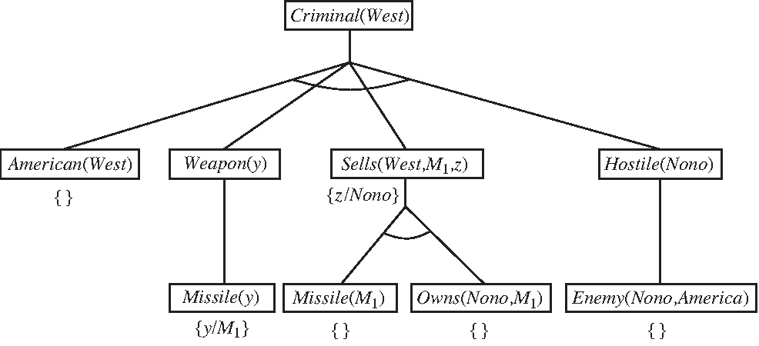
Backward chaining proof of Criminal(west)

Slide 30
Pros and cons of backward chaining
Pros:
Focuses attention on rules relevant to the goal
Space linear in the size of the proof
Cons:
May try to establish the same goal repeatedly (tree search)
Not complete due to possibility of infinite recursion

Slide 31
Logic programming
Can we use logic as the basis of a programming language?
Pattern matching is a powerful primitive.
  Languages like Perl provide regular expression matching.
  Logic programming languages use unification.
Depth-first search with automatic backtracking is handy for some problems.
Prolog is the most common logic programming language.

Slide 32
How Prolog differs from pure logic
Database semantics used for equality and negation
Built-in arithmetic functions; don’t need Peano’s axioms
Side effects, e.g., for i/o, or for updating the KB
No occur check, so inference is unsound (but quick)
Depth-first backward chaining with no checks for infinite recursion
Rule order matters
Programmer has some control of backtracking via cut operator

Slide 33
Prolog syntax
First order logic:
P(x) ∧ Q(x,y) ∧ R(y) ⇒ S(x,y)
reverse:
S(x,y) ⇐ P(x) ∧ Q(x,y) ∧ R(y)
Prolog:
s(X,Y) :- p(X), q(X,Y), r(Y).

Slide 34
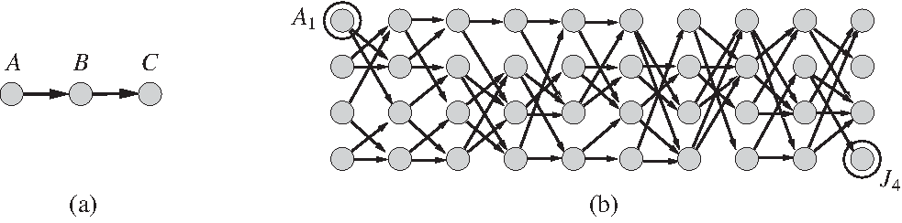
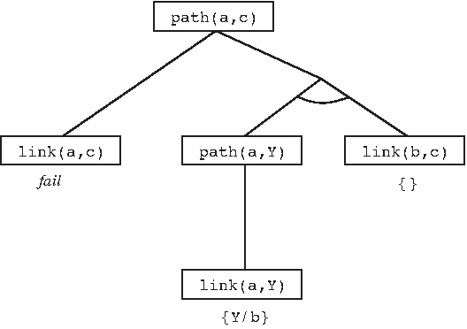
Rule order matters
path(X,Z) :- link(X,Z).
path(X,Z) :- path(X,Y), link(Y,Z)

Slide 35
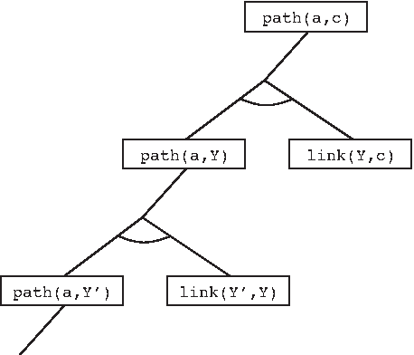
Rule order matters
path(X,Z) :- path(X,Y), link(Y,Z)
path(X,Z) :- link(X,Z).
Infinite recursion!

Slide 36
Depth-first backtracking search can be expensive
path(X,Z) :- link(X,Z).
path(X,Z) :- path(X,Y), link(Y,Z)
Finding a path from A₁ to J₄ requires 877 inferences.

Slide 37
Constraint logic programming
Backtracking search works only for finite-domain CSPs.
What if we want to reason about inequalities?
triangle(X,Y,Z) :- X>0, Y>0, Z>0, X+Y>=Z, Y+Z>=X, X+Z>=Y.
Constraint logic programming allows variables to be constrained rather than bound.
  Combines constraint satisfaction techniques with logic, deductive databases, and linear programming.

